Slide 1
License Plate Recognition
Fulong Wang
10406079
EE 800-L 2017 Spring

Slide 2
Outline
Image processing
Gray-level and contrast enhancement
Edge Detection, erosion, and dilation
Segmentation
Extraction
Splitting characters
Recognition
Method 1: Back propagation neural
network algorithm (letters and numbers)
Method 2: Templates matching
(Chinese characters)
Recognizing
Start
Image processing
Localization
Characters and numbers segmentation
Feature extraction of the segmented image
Recognize the features
Show the result
end
Notes:
I will give a quick review of the part 1 and part 2.

Slide 3
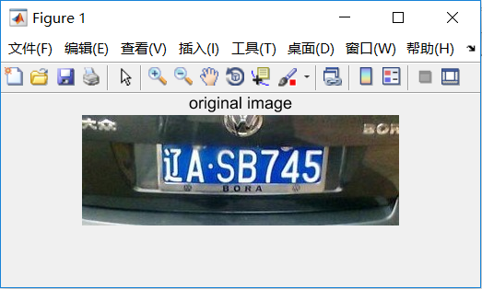
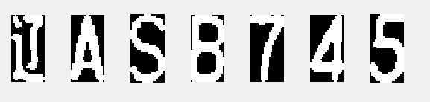
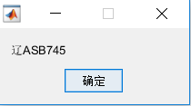
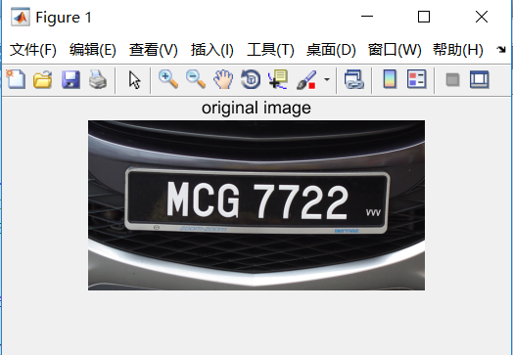
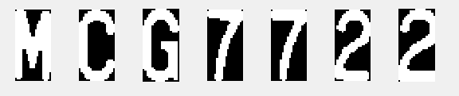
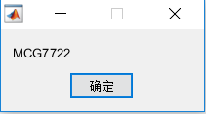
Introduction
Notes:
First of all, I would like to give a brief introduction of the project.
The car license plate recognition can be used in several fields:
like the traffic control in restricted areas.
like the automatic payments of the highways and bridges
and some general security systems.
For humans the license plate can be easily to recognize. But for the machine,

Slide 4
Image Processing: Gray-level and Contrast Enhancement
I = rgb2gray(RGB)
I = 0.2989 * R + 0.5870 * G + 0.1140 * B
J = imadjust(I,[low_in; high_in],[low_out; high_out])
Notes:
It can improve the quality of the image in case of poor illumination.

Slide 5
Image Processing: Edge Detection, Erosion, and Dilation
Notes:
The next several steps are localizing the region of the license plate. The edge detection is one of the basic function that is widely used in image processing.

Slide 6
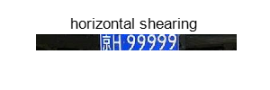
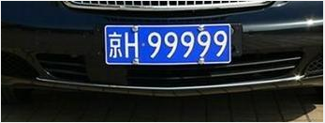

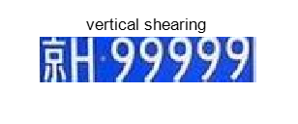
Segmentation: Extraction
Horizontally Shearing
Vertically Shearing
Notes:
Now we are coming into the segmentation part.
This part is to extract the license plate region and segment every characters.

Slide 7
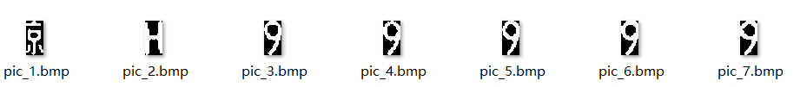
Segmentation: Splitting Characters

Slide 8
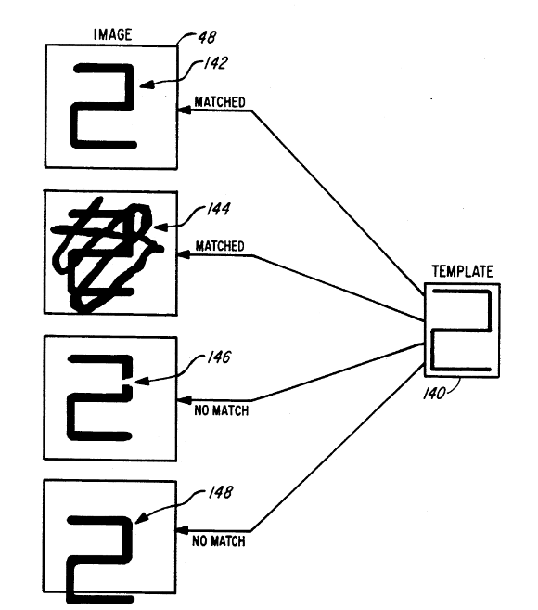
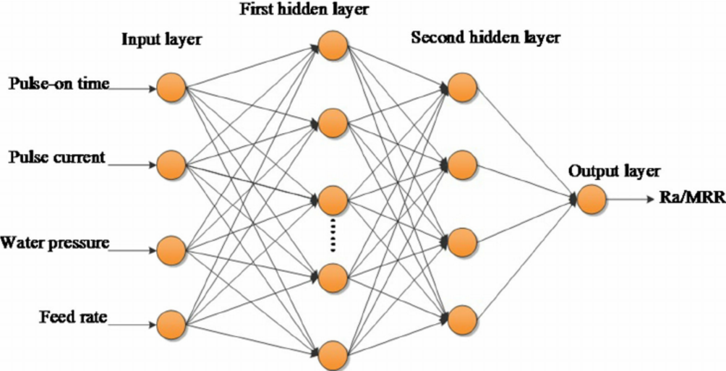
Recognition: OCR ( Optical Character Recognition )
Algorithm based on neural network:
Used on letters and numbers.
Algorithm based on templates matching:
Used on Chinese characters.
Templates Matching
Back Propagation Neural Network
Notes:
In the recognition part, The optical character recognition which is called the OCR, it has 2 kinds of algorithms. One is based on neural network and another one is based on templates matching.

Slide 9
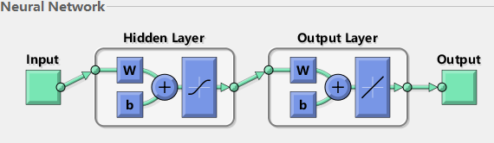
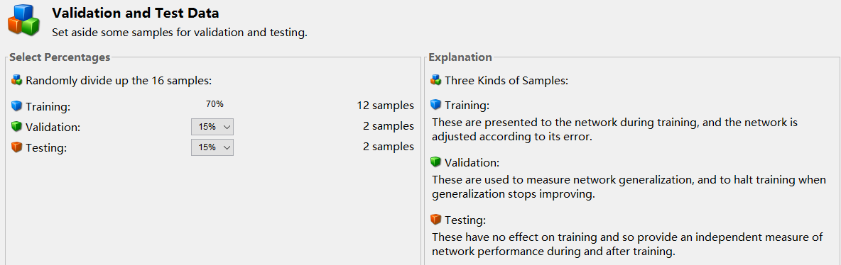
Back Propagation Neural Network Algorithm
Neural network pattern recognition toolbox in MATLAB
Notes:
I need to set the input and the form of the output. 70% of the samples are used for training, 15% are used for validating the network. And the last 15% are used as the independent test of the network generalization.

Slide 10
Test Records of Dataset
Test records of letters
 | samples | correct | incorrect | accuracy
A | 16 | 16 | 0 | 100%
B | 18 | 12 | 6 | 66.67%
C | 12 | 12 | 0 | 100%
D | 17 | 16 | 1 | 94.12%
E | 11 | 9 | 2 | 81.82%
F | 17 | 13 | 4 | 76.47%
G | 15 | 11 | 4 | 73.33%
H | 5 | 4 | 1 | 80.00%
J | 15 | 15 | 0 | 100%
K | 11 | 11 | 0 | 100%
L | 10 | 10 | 0 | 100%
M | 9 | 9 | 0 | 100%
N | 6 | 6 | 0 | 100%
P | 11 | 11 | 0 | 100%
Q | 8 | 4 | 4 | 50.00%
R | 3 | 2 | 1 | 66.67%
S | 9 | 6 | 3 | 66.67%
T | 8 | 8 | 0 | 100%
U | 3 | 3 | 0 | 100%
V | 11 | 11 | 0 | 100%
W | 6 | 6 | 0 | 100%
X | 10 | 10 | 0 | 100%
Y | 10 | 10 | 0 | 100%
Z | 6 | 6 | 0 | 100%
total | 247 | 221 | 26 | 89.47%
Test records of numbers
 | samples | correct | incorrect | accuracy
0 | 15 | 12 | 3 | 80.00%
1 | 12 | 7 | 5 | 58.00%
2 | 14 | 14 | 0 | 100%
3 | 10 | 10 | 0 | 100%
4 | 12 | 12 | 0 | 100%
5 | 12 | 12 | 0 | 100%
6 | 10 | 10 | 0 | 100%
7 | 11 | 10 | 1 | 90.91%
8 | 14 | 14 | 0 | 100%
9 | 16 | 15 | 1 | 93.75%
total | 126 | 116 | 10 | 92.06%

Slide 11
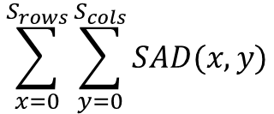
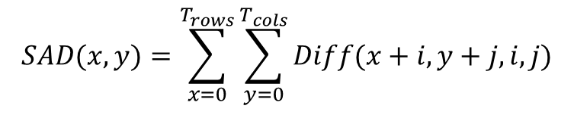
Templates Matching Algorithm
S(x, y)
$$SAD(x,y)=\sum_{x=0}^{T_{rows}}{\sum_{y=0}^{T_{cols}}{Diff(x+i,y+j,i,j)}}$$
Input
$$\sum_{x=0}^{S_{rows}}{\sum_{y=0}^{S_{cols}}{SAD(x,y)}}$$
T(x_{t}, y_{t})
where
$$Diff\left(x_{s},y_{s},x_{t},y_{t}\right)=\left|l_{s}\left(x_{s},y_{s}\right)−l_{t}\left(x_{t},y_{t}\right)\right|$$
Template 1
Template 2
Template 3
28%
24%
96%
Notes:
The algorithm based on templates matching uses a convolution mask.
In the formula, the T(x,y) is the template, where (xt,yt) represent the coordinates of each pixel in the template.
I define the I(x,y) as the intensity of the corresponding coordinates, so that I can get the difference between the template and the input image of each pixel.
I use the sum of the absolute differences(SAD) to measure the similarity between the input image and the template. It is a convolution process.
Then I compare the input with all templates to find the most similar one as the result

Slide 12
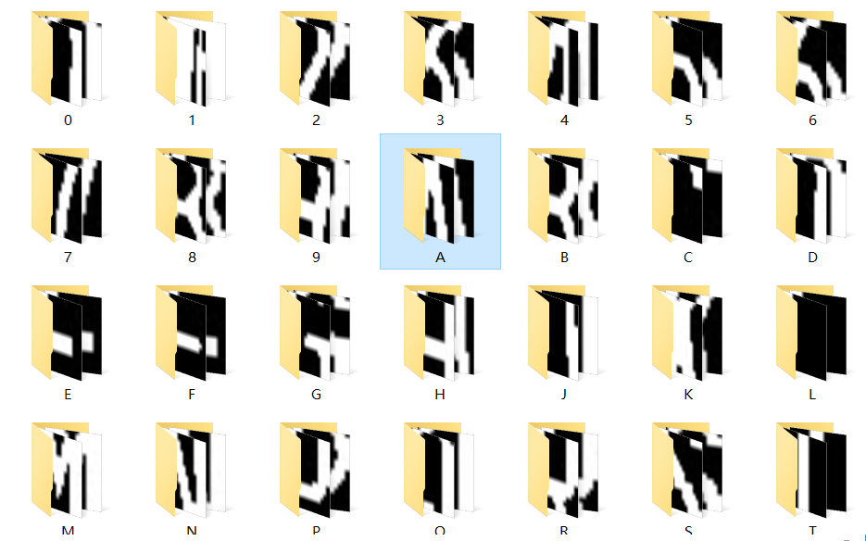
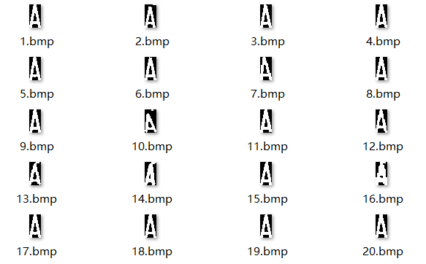
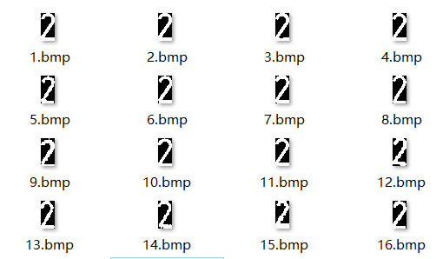
Dataset: Letters and Numbers

Slide 13
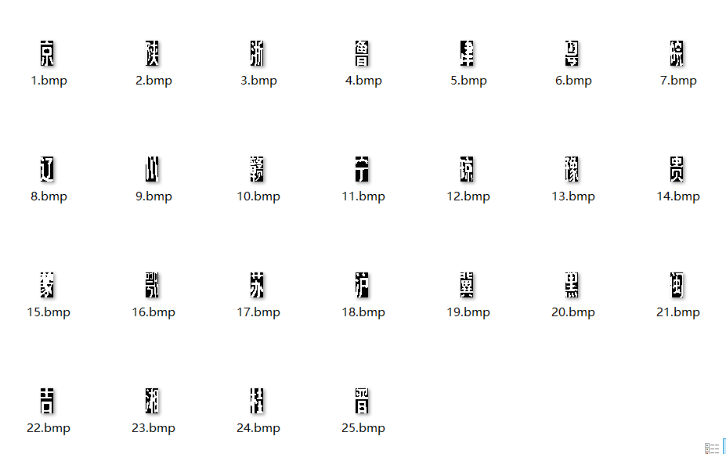
Dataset: Chinese Characters

Slide 14
Future Work
Make the system can deal with the photo in profile and with low quality.
Improve the accuracy of the recognition part.

Slide 15
Reference
N. Wang, X. Zhu and J. Zhang, "License Plate Segmentation and Recognition of Chinese Vehicle Based on BPNN," 2016 12th International Conference on Computational Intelligence and Security (CIS), Wuxi, 2016, pp. 403-406.
J. P. D. Dalida, A. J. N. Galiza, A. G. O. Godoy, M. Q. Nakaegawa, J. L. M. Vallester and A. R. d. Cruz, "Development of intelligent transportation system for Philippine license plate recognition," 2016 IEEE Region 10 Conference (TENCON), Singapore, 2016, pp. 3762-3766.
Y. Yuan, W. Zou, Y. Zhao, X. Wang, X. Hu and N. Komodakis, "A Robust and Efficient Approach to License Plate Detection," in IEEE Transactions on Image Processing, vol. 26, no. 3, pp. 1102-1114, March 2017.

Slide 16
Conclusion
Image processing part
Segmentation part
Recognition part
Algorithm based on neural network
Algorithm based on templates matching

Slide 17
Thank you

